Slide 1

HTML and CSS Chapter 3: Forms
By the end of this chapter, you will be able to use the correct HTML form elements to build an online form; customize form elements to improve the look and feel of your web forms

Slide 2
Introduction
In the previous chapters, we studied how to build web pages that contain static textbased content. From this chapter onward, we will learn how to make web pages much more interesting, starting with forms.
Forms allow users to actually interact with a website. They enable users to sign up for services, order products online, and so on. Forms are arguably one of the most crucial aspects of business websites, as without forms no transactions can take place online. Businesses require online forms to capture user details when creating new user accounts, for instance, to allow users to select flight details when booking a holiday online. Without forms, many online businesses would not be able to function. With this in mind, developing complex forms is an essential skill to add to your toolbelt as a web developer.
In this chapter, we will take a look at the most common elements that are used to build forms with HTML. These HTML elements include text inputs, radio buttons, checkboxes, text areas, submit buttons, and so on. Once we've gained an understanding of the most commonly used form elements, we will look at styling concerns. This will include techniques to make our form elements look visually appealing to a wide range of users. We will put all of this into practice by building different online forms.

Slide 3
Form Elements
HTML provides us with a variety of elements that are used for building forms. While browsing the web, you must have noticed that online forms typically have similar elements. Most forms will contain input fields such as text inputs, checkboxes, and select boxes.
In this section, we will look at the following HTML form elements:
form
input
label
textarea
fieldset
select
button

Slide 4

The form Element
The first element we need to know about when creating forms is the form element. This is the outermost element, which contains all other form elements, such as inputs and buttons. The form element requires you to pass two attributes, which are the action and method attributes. The action attribute allows the developer to specify the URL where the form data will go to after it has been submitted. The method attribute allows the developer to specify whether the form data should be sent via get or post. You will typically use the get method when you are dealing with unsecured data since the data will be present in a query string. On the other hand, the post method is typically used when dealing with secure data, or when dealing with a large amount of soft data. The following code snippet shows an example of what an empty form would look like in HTML:

Slide 5
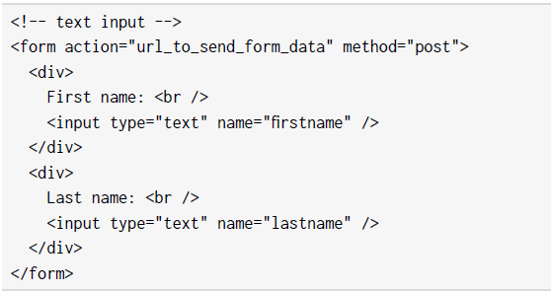
The input Element
Now that we have our form element, we can start building the form using different elements. The first one we will look at is the input element. This is the element you would use when creating text input fields, radio buttons, and checkboxes. The input element is the most important of all the form elements we will look at and you will find yourself using it over and over again. The input element requires two attributes, which are type and name. The type attribute is used to specify what type of input you want, such as radio buttons, checkboxes, or text. The name attribute gives the element a unique name that is required when submitting the form. This is so that the form's data can be organized into key-value pairs with a unique name corresponding with a value. It should be noted that the order that you add the attributes in has no significance. The following code snippet shows how to create a text field using the input element:

Slide 6
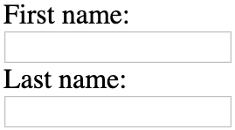
The input Element
The following figure shows the output for the preceding code:
Sometimes, when creating text inputs, you will want to limit the number of characters a user can add. A common example of this is when you want to restrict the number of characters for a new username in account signup forms. You can use the maxlength attribute and set the maximum number of characters allowed for the input field. The following code snippet shows how you would use this attribute:
Figure 4.1: Text inputs shown in the browser

Slide 7
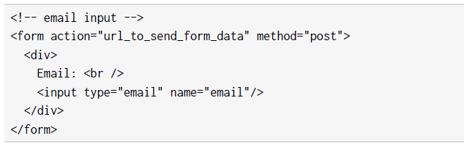
The input Element
There is also a specialist type of text input that is solely for email addresses. To create an email input, you simply set the type to "email". This input type has built-in validation that checks whether the input text is a valid email address. The following code snippet shows how to create an email input:
The following figure shows the output for the preceding code:
Figure 4.2: Email input shown in the browser

Slide 8
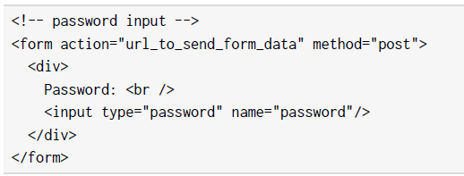
The input Element
There is a type of text input that is used solely for passwords. To create a password input, you simply set the type to "password". This input type will mask the text entered by the user to hide the password text. The following code snippet shows how to create a password input:
The following figure shows the output for the preceding code:
Figure 4.3: Password input shown in the browser

Slide 9
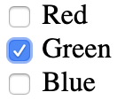
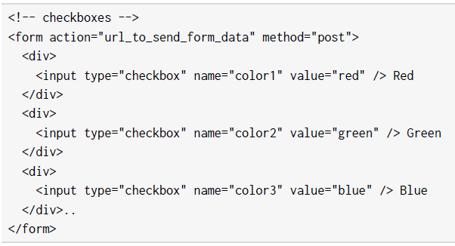
The input Element
When using checkboxes, you will give all of them a unique value for the name attribute and you will need to give each checkbox a unique value attribute, as shown in the following code:
The following figure shows the output for the preceding code:
With checkboxes, you can select multiple values at a time. A common use case for checkboxes is when selecting multiple filters to search results.
Figure 4.4: Checkboxes shown in the browser

Slide 10
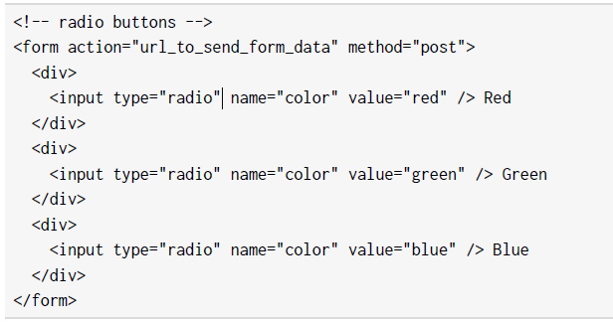
The input Element
When using radio buttons, you will give all of them the same value for the name attribute since there can only be one value selected. You will, however, need to give each radio button a unique value attribute, as shown in the following code snippet:
The following figure shows the output for the preceding code:
In contrast to checkboxes, with radio buttons, the user can select only one value. A common use case for radio buttons is when selecting a delivery option when ordering online.
Figure 4.5: Radio buttons shown in the browser

Slide 11
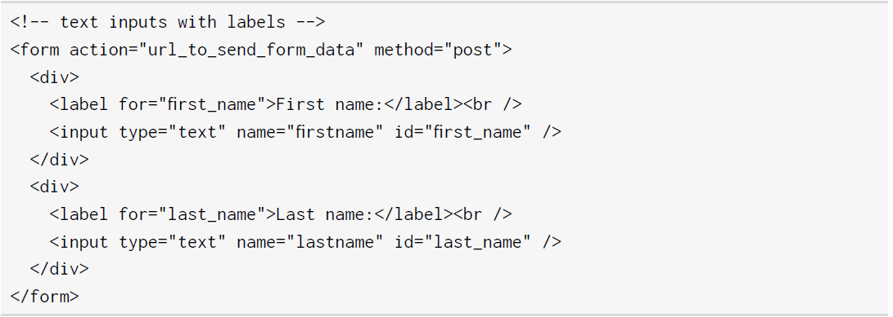
The label Element
Now that we know how to create text inputs, checkboxes, and radio buttons, we need to look at the label element. In the previous examples, you might have noticed that we had text associated with the input fields either before or after an input element. The label element allows us to associate a piece of text with a form element and allows us to select the form element by clicking on the text. If we were to just include some text, as we did in Figure 4.1, we would lose this benefit and make our form less accessible for screen reader users since there would not be an associated label to call out when presenting a form element. The label element has an attribute called for, which we need to give the id for the element we wish to associate the label with. The following code snippet shows this in action:

Slide 12
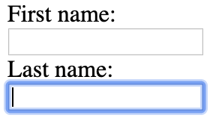
The label Element
The following figure shows the output for the preceding code:
Figure 4.6: Text inputs with labels shown in the browser

Slide 13
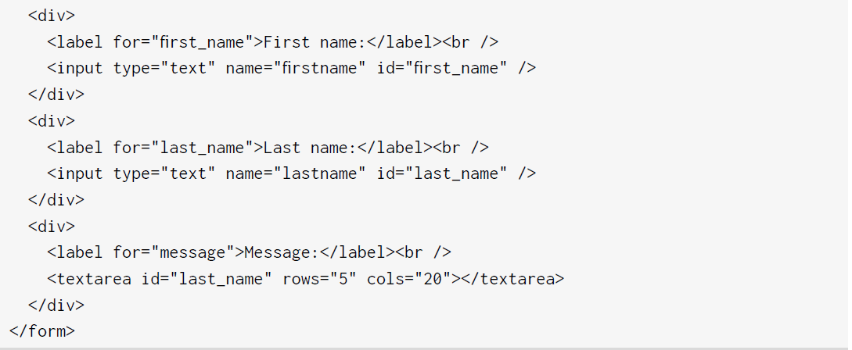
The textarea Element
Imagine you are creating a "comments" section for a community web page. You might want a user to comment on a video or a blog post. However, using a text input is not ideal for long text messages. In such scenarios, when you want to allow the user to add more than one line of text, you can use the textarea element to capture larger amounts of text. You can specify the size of the textarea with the rows and cols attributes. The following code snippet shows how to include textarea within a form:

Slide 14
Lists
The following figure shows the output for the preceding code:
Figure 4.7: Textarea shown in the browser

Slide 15
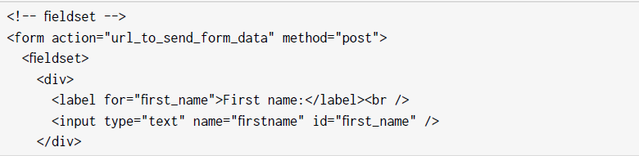
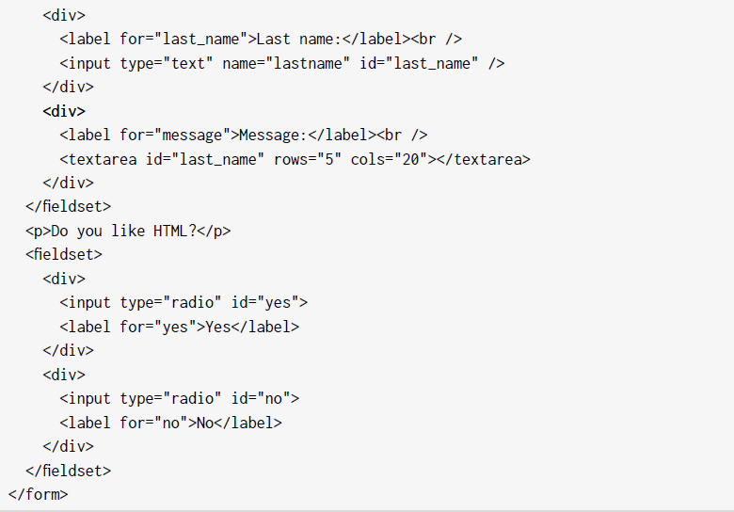
The fieldset Element
HTML provides us with a semantic tag to group related form elements and it is called the fieldset element. This element is mostly used with larger forms when you want to group related form elements together. You will probably have used online forms that make use of the fieldset element without realizing it. A common use case is when you have a large form with a section for personal details and a section for delivery details. Both of these sections of the form would be wrapped in a fieldset element. The following shows how we could include more than one form using fieldset:

Slide 16
The fieldset Element
The following figure shows the output for the preceding code:
Figure 4.8: Form with fieldset shown in the browser

Slide 17
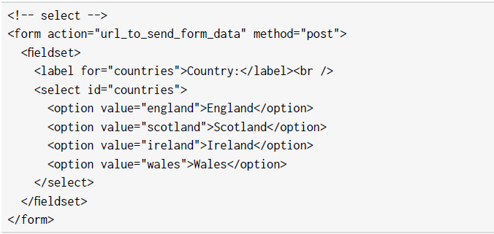
The select Element
HTML provides us with the select element for creating select boxes. These are typically used when you have a long list of options and you want the user to select only one. Some common examples include lists of countries, addresses, and year of birth. Inside the select element, you provide a list of options inside of an option element. The following shows an example of how this looks in HTML:

Slide 18
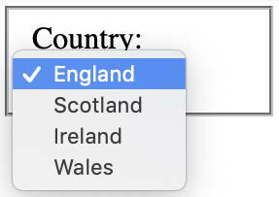
The select Element
The following figure shows the output for the preceding code:
By clicking on the blue arrows on the right-hand side of the select box, we will get the options displayed in the following figure:
Figure 4.9: Select box closed, shown in the browser
Figure 4.10: Select box open, shown in the browser

Slide 19
The button Element
Finally, now that we have a range of form elements we can use for building web forms, we now just need to know how to submit a form. The button element requires a type attribute that can have three different values. Firstly, the button value, which has no default behavior; the "reset" value, which, once clicked, will reset all form values; and finally, the "submit" value, which will submit the form once clicked. For this, we use the button element and give a value of "submit" in the type attribute:

Slide 20
Exercise 1: Creating a Simple Form
In this exercise, we will write the HTML to create a simple web form. Our aim will be to produce the following web form:
Figure 4.11: A simple web form shown in the browser

Slide 21
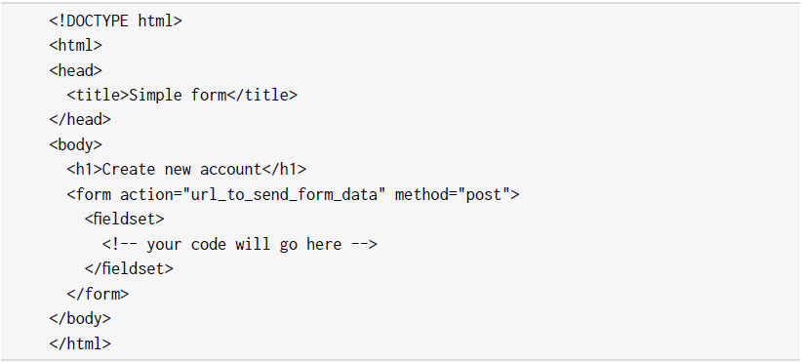
Exercise 1: Creating a Simple Form
Let's complete the exercise with the following steps:
1. First, start by creating a new file in VSCode called simple-form.html and use the following code as your starting point:

Slide 22
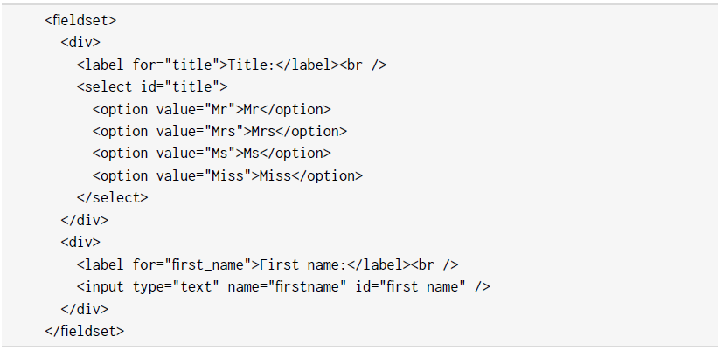
Exercise 1: Creating a Simple Form
2. First, we will add the HTML for the title and first name fields between the opening and closing fieldset elements:

Slide 23
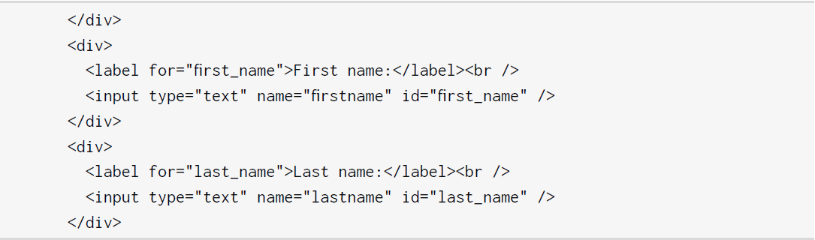
Exercise 1: Creating a Simple Form
3. Next, we will add the HTML for the last name field. We will add this after the closing div element, which wraps the HTML for the first name field:

Slide 24
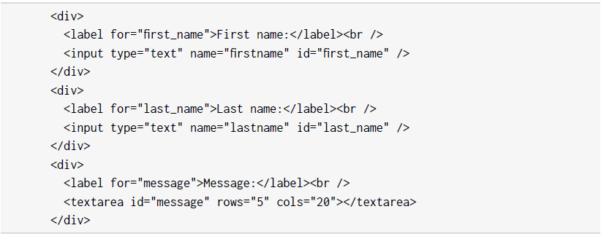
Exercise 1: Creating a Simple Form
4. Now we will add the HTML for the message field. Notice how this will be a textarea element instead of an input element to allow the user to enter more than one line of text:

Slide 25
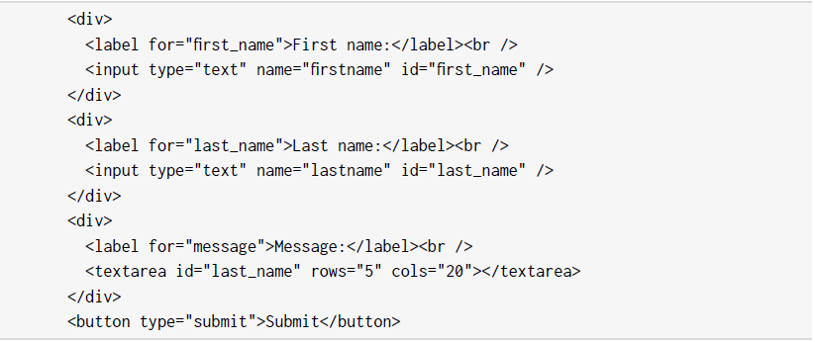
Exercise 1: Creating a Simple Form
5. Finally, we need to add the submit button as follows:

Slide 26
Exercise 1: Creating a Simple Form
If you now right-click on the filename in VSCode, on the left-hand side of the screen, and select open in default browser, you will see the form in your browser.
You should now have a form that looks like the following figure:
Now that we have become acquainted with the most commonly used HTML form elements, we will now look at how to style them.
Figure 4.12: Submit button shown in the browser

Slide 27
Styling Form Elements
In the examples in the previous section, the forms do not look very visually appealing by default, but luckily, we have the ability to improve the look and feel of our forms using CSS.
In this section, we will look at styling the following:
Textbox
Textarea
Label
Button
Select box
Validation styling

Slide 28
Label, Textbox, and Textarea
The first form elements we will look at styling are the label, textboxes, and textarea elements. These are probably the most common form elements and it is very straightforward to improve the look and feel of these elements with minimal code.
To style labels, you will typically just adjust the font you use and the size of the text. It is common to have the label element sit either on top of its associated form element or to the left.
For textboxes and textareas, typically, you will be interested in changing the size of these elements. It is common to remove the default border around these elements. Another common stylistic addition to textboxes and textareas is to add a placeholder attribute that provides the user with some text that helps them decide what needs to be typed into the textbox or textarea.

Slide 29
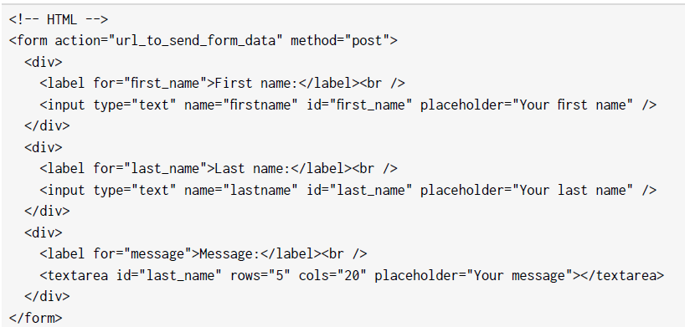
Label, Textbox, and Textarea
To illustrate an example of how to style these elements, we will start with the following markup, noting the addition of placeholder attributes:
Continue to the other slide →

Slide 30
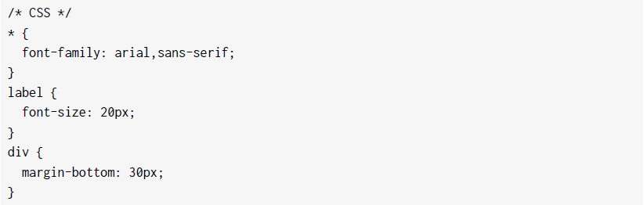
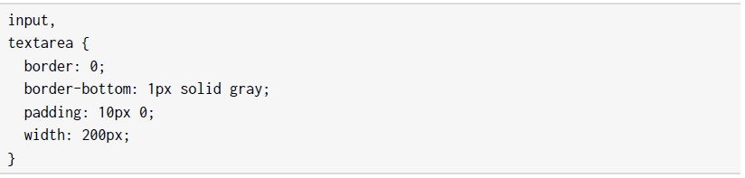
Label, Textbox, and Textarea

Slide 31
CSS Text Properties
In the preceding CSS, you will notice that we have applied a font family to all text elements. We have set the label text size to 20px and added a bottom margin to the div elements so that the form elements are nicely spaced, vertically. Finally, we have removed the default border applied to the input and textarea elements, replacing it with just a border on the bottom.
With just minimal CSS, we have improved the look and feel of our form drastically, as can be seen in the following screenshot:
Figure 4.13: Styled labels, textboxes, and textarea elements

Slide 32
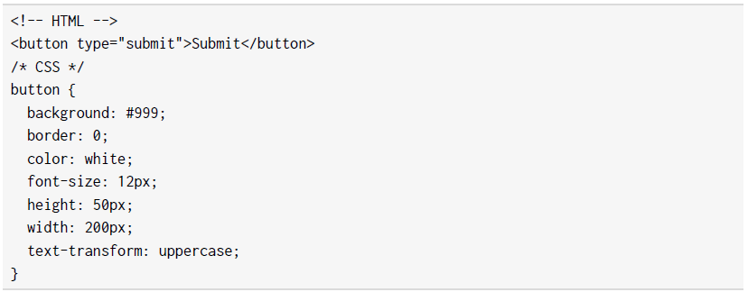
Buttons
We will now look into styling the buttons that are used to submit a web form. Typically, you will see buttons with various different background colors and with different sizes applied when viewing websites with forms. Out of the box, the button element looks pretty ugly and so you will rarely see buttons without some CSS applied to them. The following is an example of how you could style a submit button:

Slide 33
CSS Font Properties
The preceding CSS sets a background color, removes the border that is added to buttons by default, applies some styling to the button text, and finally, sets a width and height:
Figure 4.14: A styled submit button

Slide 34
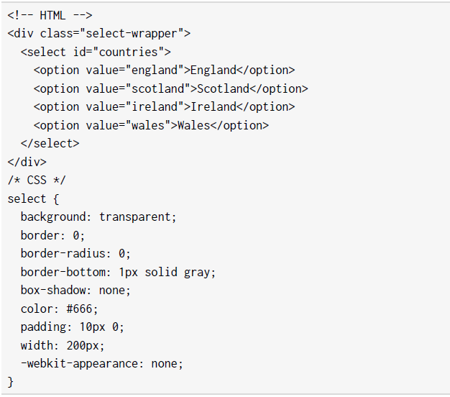
Select Boxes
The last form element we will look at for styling is the select box. Typically, these are styled with the intention of making the select box look similar to a textbox within a form. It is common for developers to add a custom styled downward-pointing arrow to the right-hand side of the select box. The following is an example of how you could style a select box:

Slide 35
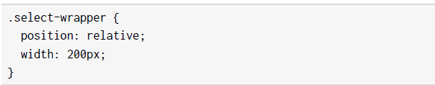
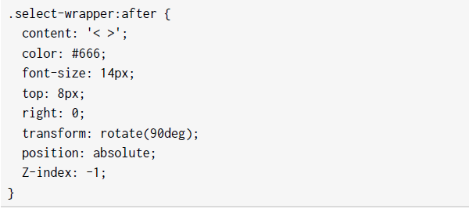
Select Boxes
The preceding CSS contains styling that essentially overrides what a select box looks like in the browser by default. Firstly, we need to remove the default background color, cancel the border, and apply just the bottom border. We also remove the custom box-shadow property, which is also applied to select boxes by default. Finally, to add a custom select box icon, we use the after pseudo selector to add the '< >' characters:
The following figure shows the output:
Figure 4.15: Styled select box

Slide 36
Validation Styling
In real-world scenarios, simply formatting and styling the form appropriately is not enough. As a web user, you may encounter cases where form validation is performed before submitting a form. For example, while registering on a website, a user may accidentally submit a form before it is filled in completely or submit an incorrectly filled in form. Validation styling comes into play when you want to highlight the fact that a form is incomplete or incorrectly filled in.
You will probably have experienced form validation on web forms you have used in the past. HTML provides us with a required attribute, which we can apply to any form elements that we require input for. The required attribute plays an important role in contact forms; for example, on the Packt website's contact form (https://packt.live/35n6tvJ), you will notice that the name and email fields are required and the user cannot submit the form until a value for each is added.
This is in contrast with some form elements where the input is optional. With CSS, we can use the :valid and :invalid pseudo selectors in order to style elements based on valid or invalid form values. We will now do an exercise that will walk us through an example of validation styles in action.

Slide 37
Exercise 2: Creating a Form with Validation Styling
In this exercise, we will develop a simple web form that contains some validation styling. Our aim will be to produce a web form like the one shown in the following figure:
Figure 4.16: Expected output

Slide 38
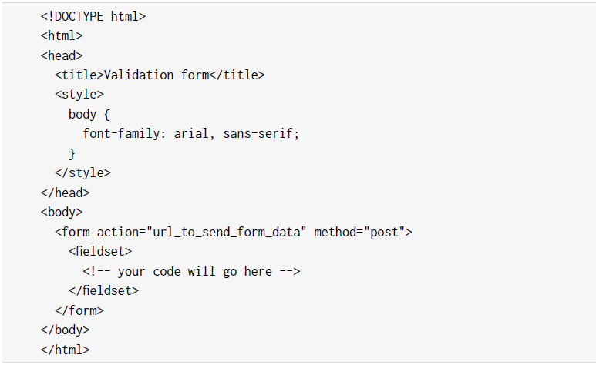
Exercise 2: Creating a Form with Validation Styling
Let's complete the exercise with the following steps:
1. First, start by creating a new file in VSCode called validation-form.html, and use the following code as your starting point:

Slide 39
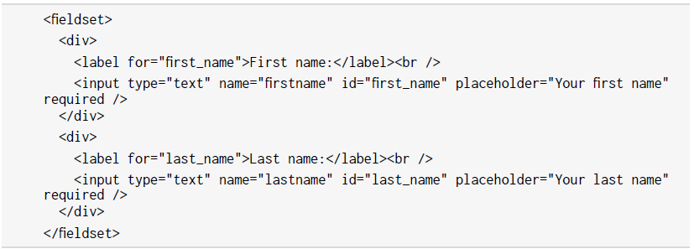
Exercise 2: Creating a Form with Validation Styling
2. We will now add the HTML for the first name and last name form fields between the opening and closing fieldset tags. Notice how we have added required attributes to both of the input elements:
Add the HTML for the remaining form elements. Notice that it is only the textarea element where we require the required attribute.

Slide 40
Exercise 2: Creating a Form with Validation Styling
2. We will now add the HTML for the first name and last name form fields between the opening and closing fieldset tags. Notice how we have added required attributes to both of the input elements:
Add the HTML for the remaining form elements. Notice that it is only the textarea element where we require the required attribute.

Slide 41
Exercise 2: Creating a Form with Validation Styling
Add the HTML for the remaining form elements. Notice that it is only the textarea element where we require the required attribute.
Look at exercise 1 for reference.

Slide 42
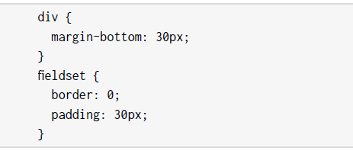
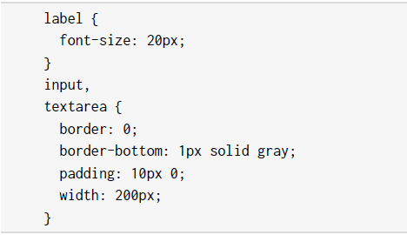
Exercise 2: Creating a Form with Validation Styling
3. Now we will turn to the CSS. We will first add some styling, which will deal with spacing the div and fieldset elements:
4. Next, we will style the individual form elements one by one. The label's font size is set to 20px and the styling for the input and textarea elements is same as shown in the following code snippet:

Slide 43
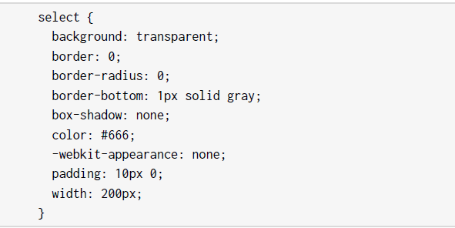
Exercise 2: Creating a Form with Validation Styling
With respect to the expected output as shown in the Figure 4.16, we style select as shown in the following code snippet:

Slide 44
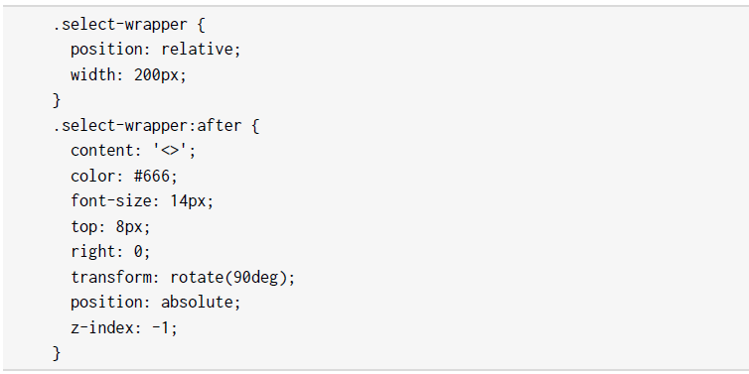
Exercise 2: Creating a Form with Validation Styling
We will use the following snippet of code to complete styling the select:

Slide 45
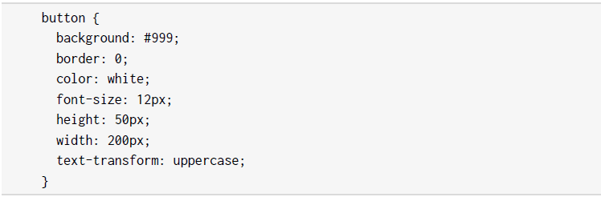
Exercise 2: Creating a Form with Validation Styling
For styling the button, we will use the styling as shown in the following code snippet:

Slide 46
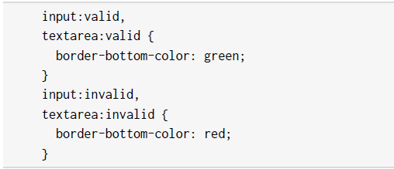
Exercise 2: Creating a Form with Validation Styling
5. Finally, we will add the styles to validate the form elements that have a required attribute:

Slide 47
Exercise 2: Creating a Form with Validation Styling
If you now right-click on the filename in VSCode, on the left-hand side of the screen, and select open in default browser, you will see the form in your browser. When you try to submit an incomplete form that has validation in it, the form will not submit and you will see something like the following screenshot:
Figure 4.17: Screenshot of the resultant form

Slide 48
Video Store Forms
From the video store product page examples from the previous chapter, where we built
a whole web page, component by component, we will now build two complex forms for
the video store project in order to put our new knowledge into practice.

Slide 49
Exercise 3: New Account Signup Form
In this exercise, we will write the HTML and CSS to create an account signup form. Our aim will be to produce a web form like the following wireframe:
Figure 4.18: Wireframe of a new account form

Slide 50
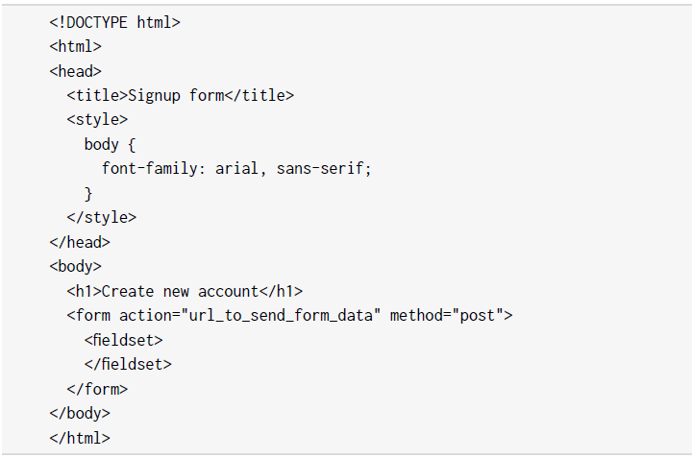
Exercise 3: New Account Signup Form
Let's complete the exercise with the following steps:
1. First, start by creating a new file in VSCode called signup-form.html, and use the following code as your starting point:

Slide 51
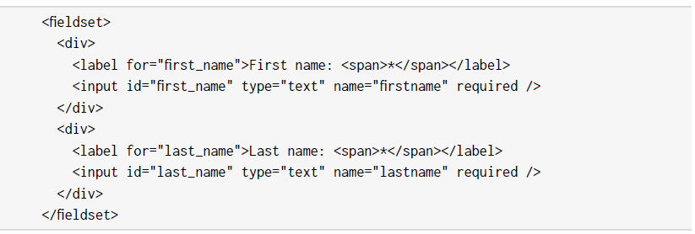
Exercise 3: New Account Signup Form
2. Now, we will add the HTML for the form up until just before the checkbox. Notice how we have added the required attribute to the elements that we require the user to provide a value for:

Slide 52

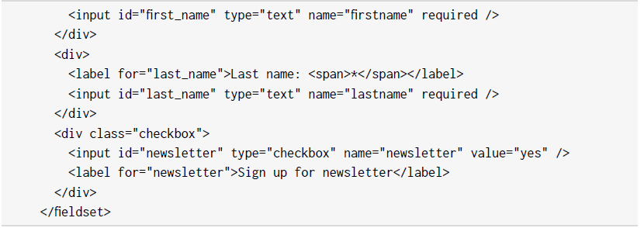
Exercise 3: New Account Signup Form
3. Next, we will add the checkbox for signing up to the newsletter. In order to have the checkbox first and the description later, label comes after input:

Slide 53
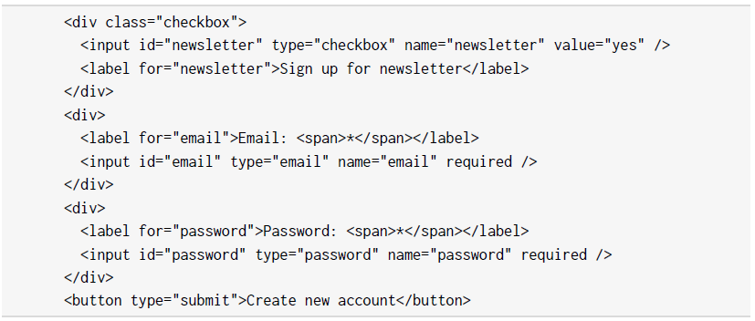
Exercise 3: New Account Signup Form
4. Now, we will add the remaining fields and the submit button below the checkbox shown in the wireframe. Again, pay attention to adding the required attribute to elements that need a value to be provided:

Slide 54
Exercise 3: New Account Signup Form
5. If you look at the HTML file in your web browser, you should now have a web page that looks like the following screenshot:
Figure 4.19: Unstyled signup form in the browser

Slide 55
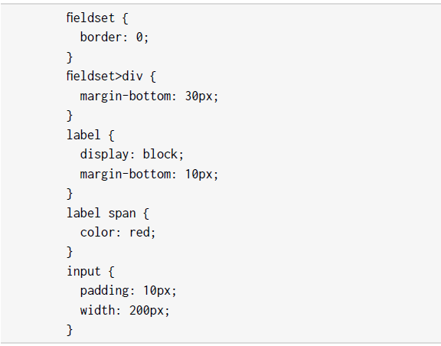
Exercise 3: New Account Signup Form
6. We can now add the CSS to style the form so that it more closely resembles the form shown in the preceding wireframe. We will start by applying some styles that deal with the spacing of elements and styling the red asterisks shown in the wireframe. The following code snippet will be inside the style tag following the font style applied to the body element:

Slide 56
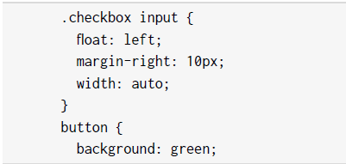
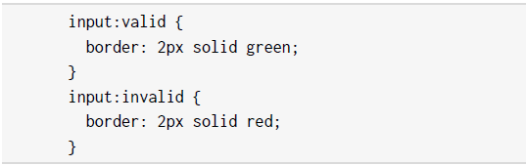
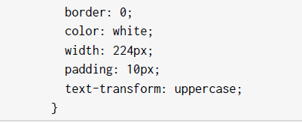
Exercise 3: New Account Signup Form
7. Next, we will apply some styles for the valid and invalid states for the text inputs. Feel free to change the colors of these styles to suit your own taste:
8. Next, we will add some styling for the checkbox and the submit button, as shown in the following code. Again, feel free to adjust the colors to suit your needs:

Slide 57
Exercise 3: New Account Signup Form
If you now right-click on the filename in VSCode, on the left-hand side of the screen, and select open in default browser, you will see the form in your browser.
You should now have a form that looks like the following figure:
Figure 4.20: Styled signup form in the browser

Slide 58
Exercise 3: New Account Signup Form
9. We will now check that the email validation works correctly for the form by adding some text in the email field that isn't a valid email address:
Figure 4.21: Form showing an invalid email address

Slide 59
Exercise 3: New Account Signup Form
10. Next, we will check all of the required field validations by trying to submit the form without adding input for any of the required fields:
We have now completed the signup form for our video store. We will also need to create a checkout page to allow the user to complete their online purchases. The next exercise will show how you can create a checkout form.
Figure 4.22: A form highlighting fields that are required to be filled in to submit the form

Slide 60
Exercise 4: Checkout Form
In this exercise, we will write the HTML and CSS to create a checkout form. We will make use of all the concepts and form elements we have learned about in the chapter.
Our aim will be to produce a form similar to the following figure:
Figure 4.23: Checkout form wireframe

Slide 61
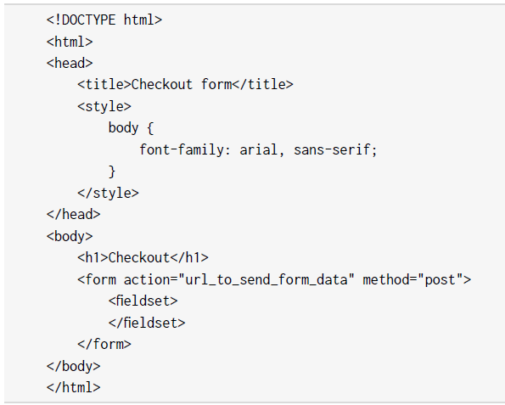
Exercise 4: Checkout Form
Let's complete the exercise with the following steps:
1. First, start by creating a new file in VSCode called checkout-form.html, and use the following code as a starting point. This gives us the skeletal HTML and CSS we will need to get started writing the checkout form:

Slide 62
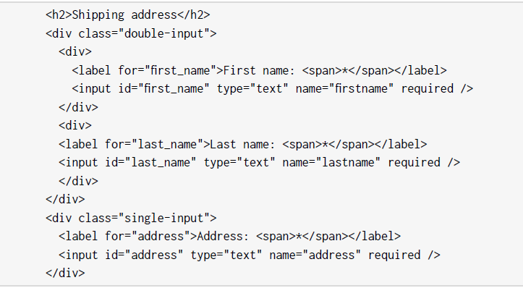
Exercise 4: Checkout Form
2. Now, we will add the HTML for the form inside the fieldset up until the address field. Notice how we have added the required attribute to the elements that we require the user to provide a value for:

Slide 63
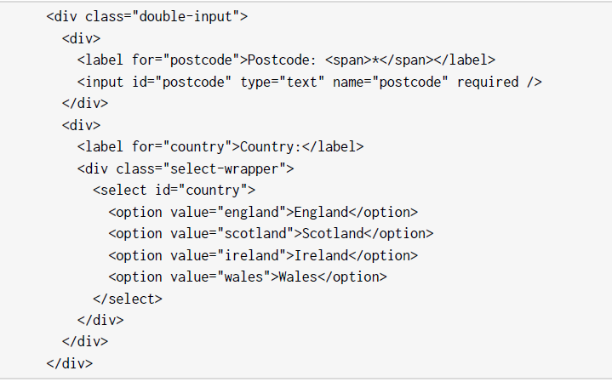
Exercise 4: Checkout Form
3. Now, below the address field we write the HTML and CSS for the postcode with input id and country using select as shown in the wireframe:

Slide 64
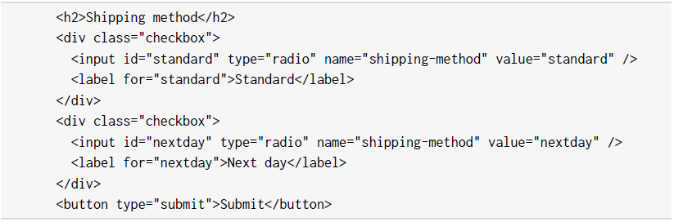
Exercise 4: Checkout Form
4. With respect to the wireframe we will now add a level 2 header followed by the radio type checkboxes as shown in the following code:

Slide 65
Exercise 4: Checkout Form
5. If you look at the HTML file in your web browser, you should now have a web page that looks like the following screenshot:
Figure 4.24: Unstyled checkout form in the browser

Slide 66
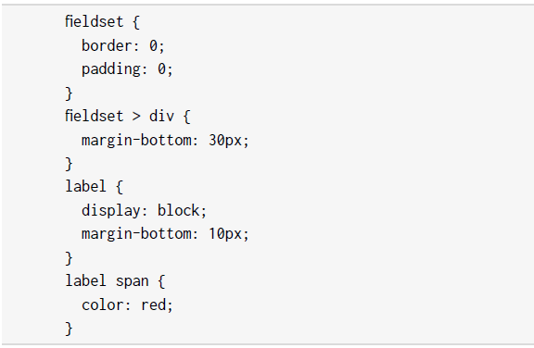
Exercise 4: Checkout Form
6. We can now add some CSS to style the form so that it more closely resembles the form shown in the preceding wireframe. We will start by applying some styles that deal with the spacing of elements and styling the red asterisks shown in the wireframe:

Slide 67
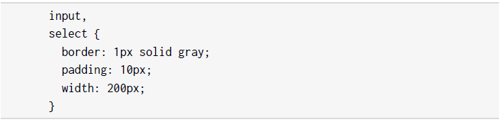
Exercise 4: Checkout Form
Notice that the input and select have same style as shown in the following code:

Slide 68
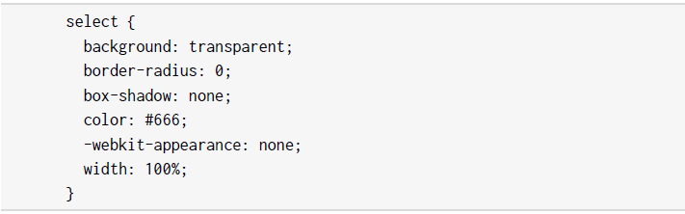
Exercise 4: Checkout Form
7. Now let's add the CSS for the select boxes. We style select as shown in the following code snippet:

Slide 69
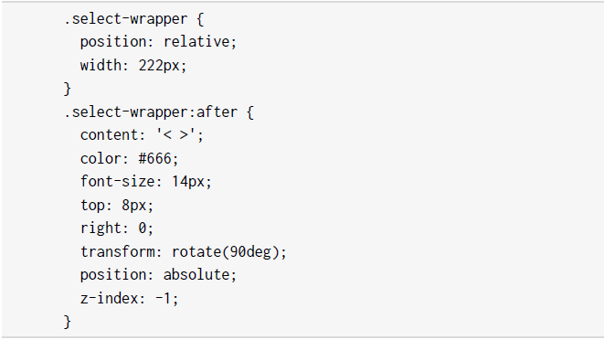
Exercise 4: Checkout Form
8. Complete styling select using the following code:

Slide 70

Exercise 4: Checkout Form
9. Finally, we will finish off the styling by adding some CSS for the inputs and the button styles, as shown in the following code:

Slide 71


Exercise 4: Checkout Form
10. Following code is added to style the button:
11. To style the inputs, we add the following code:

Slide 72
Exercise 4: Checkout Form
If you now right-click on the filename in VSCode, on the left-hand side of the screen, and select open in default browser, you will see the form in your browser.
You should now have a form that looks like the following figure:
Figure 4.25: Styled checkout form in the browser

Slide 73
Exercise 4: Checkout Form
12. Now, we will check whether the validation works for our required fields by submitting the form with empty fields. We will see something like the following screenshot:
Figure 4.26: Form highlighting the required fields before submitting

Slide 74
Activity 1: Building an Online Property Portal Website Form
An international online property website has approached you to design a search form for their listings page. This form should have the following fields: search radius, price range, bedrooms, property type, and added to the site, and an option to include sold properties in the user's search. Create your own solution using the skills you have learned in this chapter:
1. Start by creating a new file named form.html in VSCode.
2. Then, start writing the HTML for the form using the description of the fields required for this form.

Slide 75
Activity 1: Building an Online Property Portal Website Form
3. Once you are happy with the HTML you have written, you can let your creativity run wild and style the form using CSS. Make sure that you include styling for validation:
Figure 4.27: Expected output of the activity

Slide 76
Summary
In this chapter, we continued our journey into building web pages by exploring web forms. We first studied the most common form-based HTML elements, including inputs, select boxes, textareas, and buttons. We then looked at the most common styling methods for styling forms. To put this new knowledge into practice, we then built different forms.
We took some time to understand when you should use checkboxes and when to use radio buttons. We also spent some time looking at how you can add validation styles for web forms.

